Slide 1
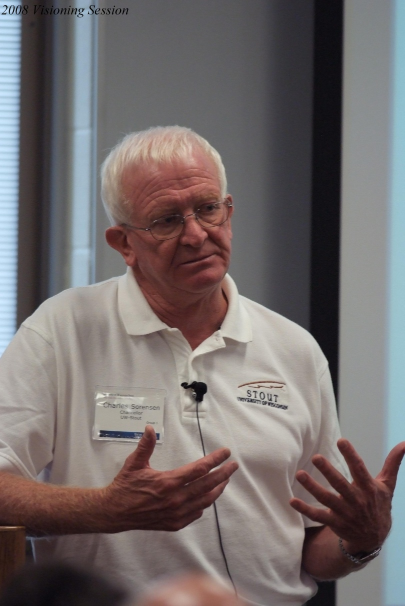
2008 Visioning Session

Slide 2
July 2010 Retreat

Slide 3
July 2009 Retreat

Slide 4
2009 Listening Session

Slide 5
2008 Visioning Session

Slide 6
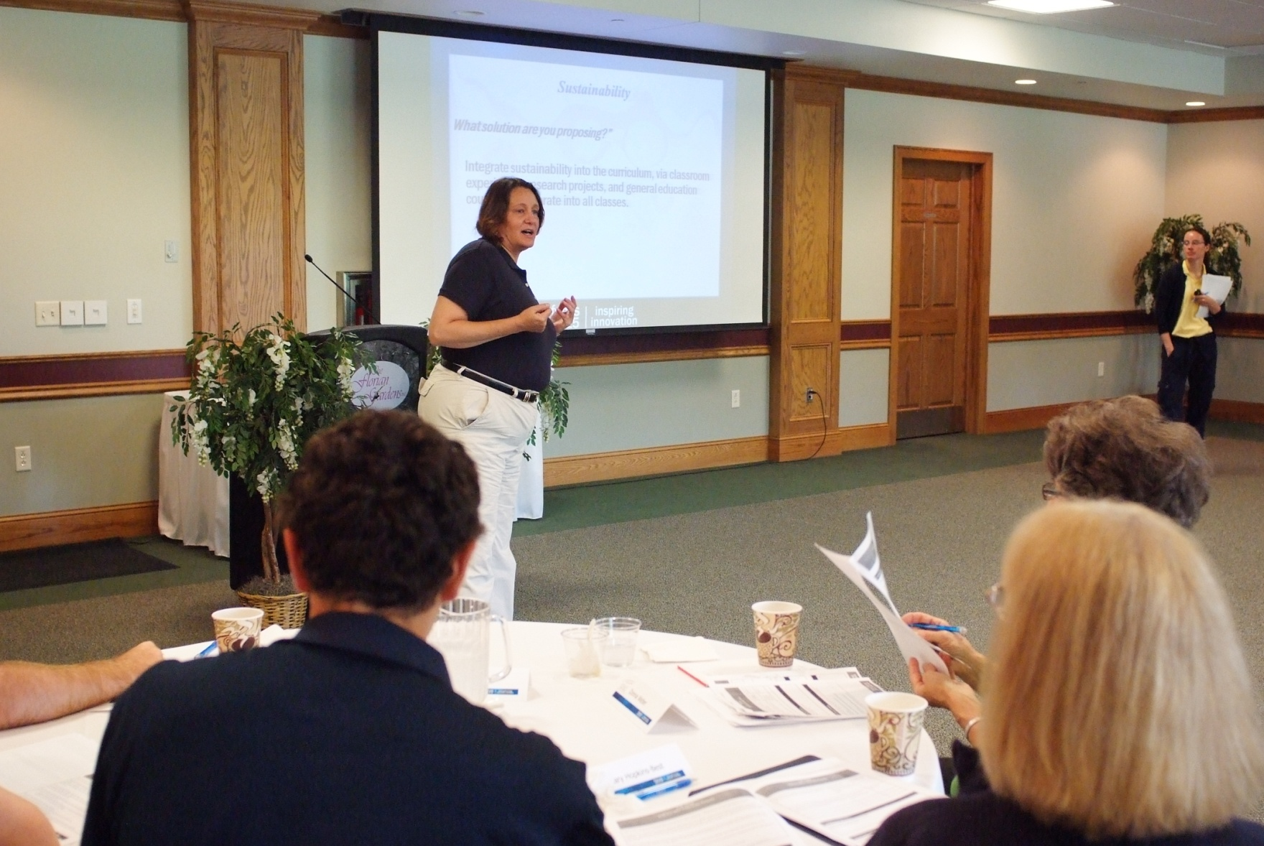
July 2010 Retreat

Slide 7
2008 Visioning Session

Slide 8
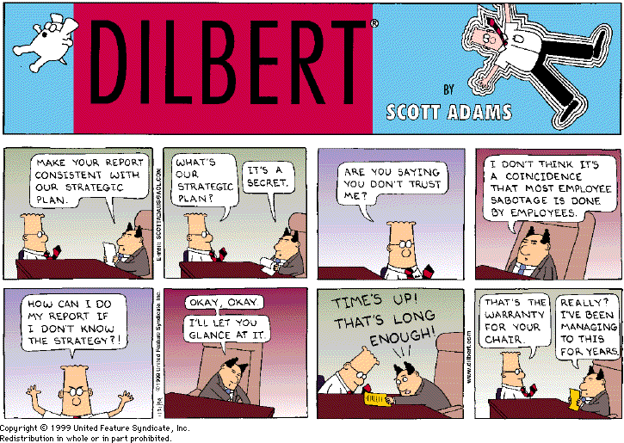

Slide 9
2009 Listening Session

Slide 10
July 2009 Retreat

Slide 11
July 2009 Retreat

Slide 12
July 2009 Retreat

Slide 13
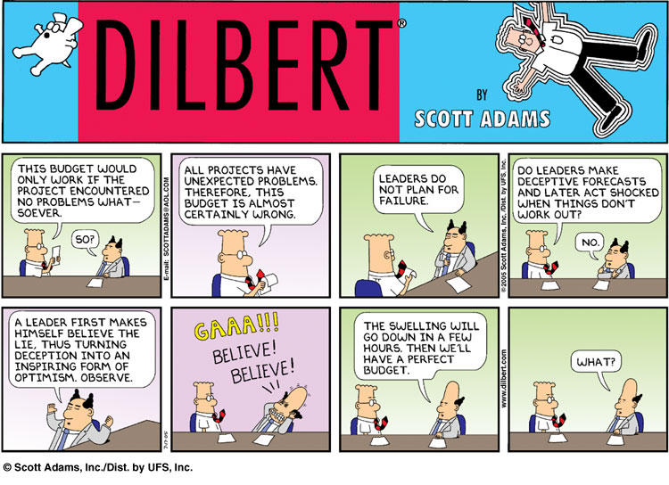

Slide 14
July 2009 Retreat

Slide 15
2008 Visioning Session

Slide 16
2008 Visioning Session

Slide 17
2008 Visioning Session

Slide 18
2008 Visioning Session

Slide 19
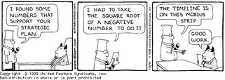

Slide 20
July 2010 Retreat

Slide 21
2008 Visioning Session

Slide 22
July 2009 Retreat

Slide 23
2009 Listening Session

Slide 24
2009 Listening Session

Slide 25
July
2009 Retreat

Slide 26
2008 Visioning Session

Slide 27
July 2009 Retreat

Slide 28
2009 Listening Session

Slide 29
July 2009 Retreat

Slide 30
2009 Listening Session

Slide 31
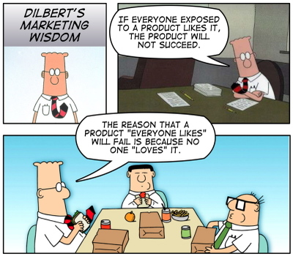

Slide 32
2008 Visioning Session

Slide 33
July 2009 Retreat

Slide 34
2008 Visioning Session

Slide 35
July 2009 Retreat

Slide 36
July 2010 Retreat

Slide 37
July 2009 Retreat

Slide 38
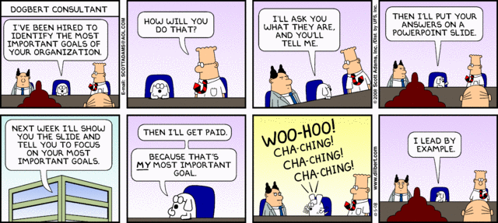

Slide 39
2009 Listening Session

Slide 40
July 2009 Retreat

Slide 41
2009 Listening Session

Slide 42
July 2009 Retreat

Slide 43
2009 Listening Session

Slide 45
2008 Visioning Session

Slide 46
2009 Listening Session

Slide 47
July 2009 Retreat

Slide 48
2008 Visioning Session

Slide 49
2008 Visioning Session

Slide 50
2008 Visioning Session

Slide 51
2009 Listening Session

Slide 52
2008 Visioning Session

Slide 53
July 2010 Retreat

Slide 54
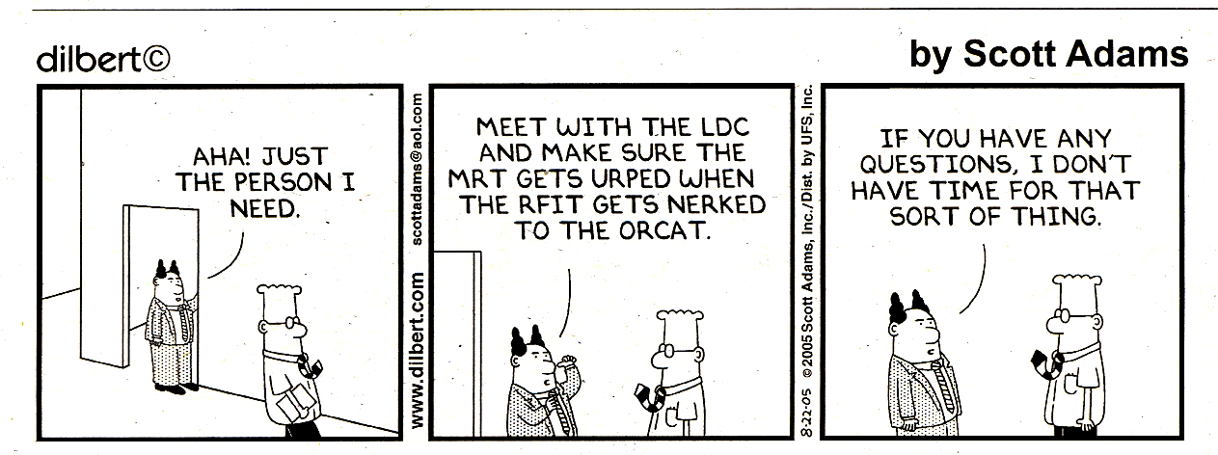

Slide 55
July 2009 Retreat

Slide 56
2009 Listening Session

Slide 57
2008 Visioning Session

Slide 58
2009 Listening Sessions

Slide 59
2008 Visioning Session

Slide 60
2009 Listening Session

Slide 61
2008 Visioning Session

Slide 62
2008 Visioning Session

Slide 63
2009 Listening Session

Slide 64
2008 Visioning Session

Slide 65
2008 Visioning Session

Slide 66
2008 Visioning Session

Slide 67
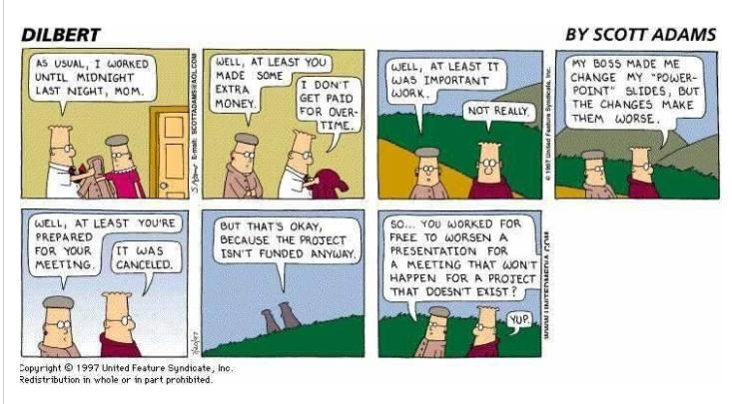

Slide 68
2008 Visioning Session

Slide 69
2008 Visioning Session

Slide 70
2009 Listening Session

Slide 71
2008 Visioning Session

Slide 72
July 2010 Retreat

Slide 74
2008 Visioning Session

Slide 75
2008 Visioning Session

Slide 76
2009 Listening Session

Slide 77
2008 Visioning Session

Slide 78
2009 Listening Session

Slide 79
July 2009 Retreat

Slide 80
2009 Listening Session

Slide 81
2008 Visioning Session

Slide 82
July 2009 Retreat

Slide 83
2008 Visioning Session

Slide 84
2008 Visioning Session

Slide 85
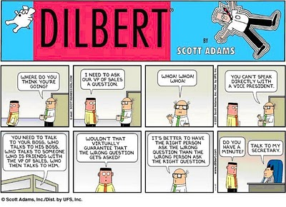

Slide 86
July 2010 Retreat

Slide 87
2008 Visioning Session

Slide 88
2008 Visioning Session

Slide 89
2008 Visioning Session

Slide 90
2008 Visioning Session

Slide 91
2008 Visioning Session

Slide 92
2008 Visioning Session

Slide 93
2008 Visioning Session

Slide 94
2008 Visioning Session

Slide 95
2008 Visioning Session

Slide 96
2008 Visioning Session

Slide 97
2008 Visioning Session

Slide 98
2008 Visioning Session

Slide 99
2008 Visioning Session

Slide 100
2008 Visioning Session

Slide 101
2008 Visioning Session

Slide 103
2008 Visioning Session

Slide 104
2008 Visioning Session

Slide 105
2008 Visioning Session

Slide 106
2008 Visioning Session

Slide 107
2008 Visioning Session

Slide 108
2008 Visioning Session

Slide 109
2008 Visioning Session

Slide 110
2008 Visioning Session

Slide 111
2008 Visioning Session

Slide 112
2008 Visioning Session

Slide 113
2008 Visioning Session

Slide 114
2008 Visioning Session

Slide 115
2008 Visioning Session

Slide 116
2008 Visioning Session

Slide 117
2008 Visioning Session

Slide 118
2008 Visioning Session

Slide 119
2008 Visioning Session

Slide 120
2008 Visioning Session

Slide 121
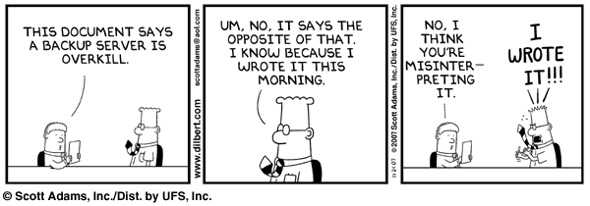

Slide 122
2008 Visioning Session

Slide 123
2008 Visioning Session

Slide 124
2008 Visioning Session

Slide 125
2008 Visioning Session

Slide 126
2008 Visioning Session

Slide 127
2008 Visioning Session

Slide 128
2008 Visioning Session

Slide 129
2008 Visioning Session

Slide 130
2008 Visioning Session

Slide 131
2008 Visioning Session

Slide 132
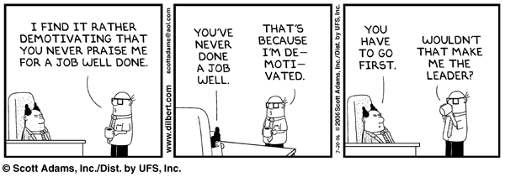

Slide 133
2008 Visioning Session

Slide 134
2008 Visioning Session

Slide 135
2008 Visioning Session

Slide 136
2008 Visioning Session

Slide 138
2008 Visioning Session

Slide 139
2008 Visioning Session

Slide 140
2008 Visioning Session

Slide 141
2008 Visioning Session

Slide 142
2008 Visioning Session

Slide 143
2008 Visioning Session

Slide 144
2008 Visioning Session

Slide 145
2008 Visioning Session

Slide 146
2008 Visioning Session

Slide 147
2008 Visioning Session

Slide 148
July 2010 Retreat

Slide 149
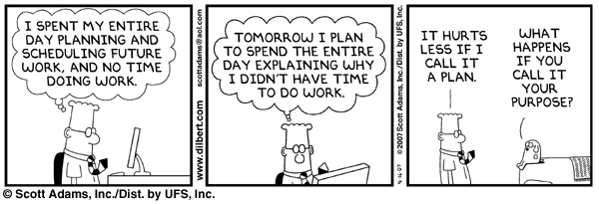

Slide 150
2008 Visioning Session

Slide 151
2008 Visioning Session

Slide 152
2008 Visioning Session

Slide 153
2008 Visioning Session

Slide 154
2008 Visioning Session

Slide 155
2008 Visioning Session

Slide 156
2008 Visioning Session

Slide 157
2008 Visioning Session

Slide 158
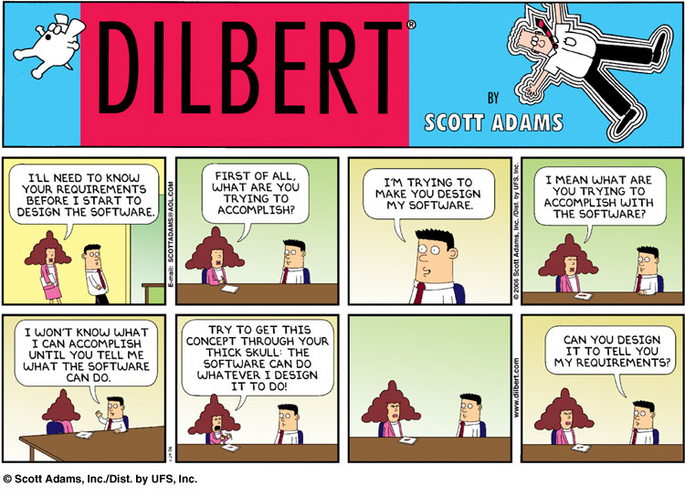

Slide 159
2008 Visioning Session

Slide 160
2008 Visioning Session

Slide 161
July 2010 Retreat

Slide 162
2008 Visioning Session

Slide 163
2008 Visioning Session

Slide 164
2008 Visioning Session

Slide 165
2008 Visioning Session

Slide 166
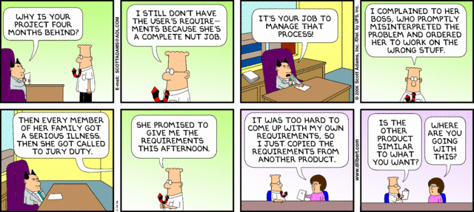

Slide 167
2008 Visioning Session

Slide 168
2008 Visioning Session

Slide 169
2008 Visioning Session

Slide 170
2008 Visioning Session

Slide 171
2008 Visioning Session

Slide 172
2008 Visioning Session

Slide 173
2008 Visioning Session

Slide 175
2008 Visioning Session

Slide 176
2008 Visioning Session

Slide 177
2008 Visioning Session

Slide 178
July 2010 Retreat

Slide 179
2008 Visioning Session

Slide 180
2008 Visioning Session

Slide 181
2008 Visioning Session

Slide 182
2008 Visioning Session

Slide 183
2008 Visioning Session

Slide 184
2008 Visioning Session

Slide 185
2008 Visioning Session

Slide 186
2008 Visioning Session

